Slide 1
Devon Hackathon FracTrac Application Team Raisa Energy 1 December 2017

Slide 2
Field App for Fracturing Operations
Challenge:
Build a mobile or desktop application that can be used on field site personnel to improve operational decisions or behaviors, during hydraulic fracturing.
Key Features/Requirements:
Gamification and interactive displays
Optimization of completion design
Better decisions on when to stop a stage
Solution:
Desktop Application
FracTrac
Real time visualization of deviations from completion design
Notifications for breeching completion design and safety thresholds
Ability to predict cost over-runs and loss of stage value
Built to be compatible with future machine learning projects
Mobile friendly

Slide 3

Video – Application Process

Slide 4

Video – Application Process

Slide 5
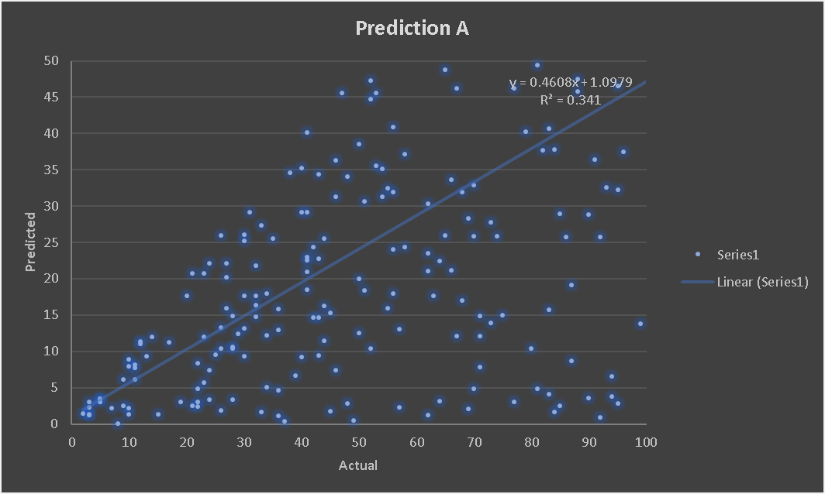
Next Steps
Capture sensor and notification data for use in machine learning projects
Integrate offset well monitoring systems to give notice of interference
Incorporate deviation surveys to aid in tortuosity induced friction calculations
Instant messaging between personnel and engineer
Complete mobile app development

Slide 6
Appendix

Slide 7
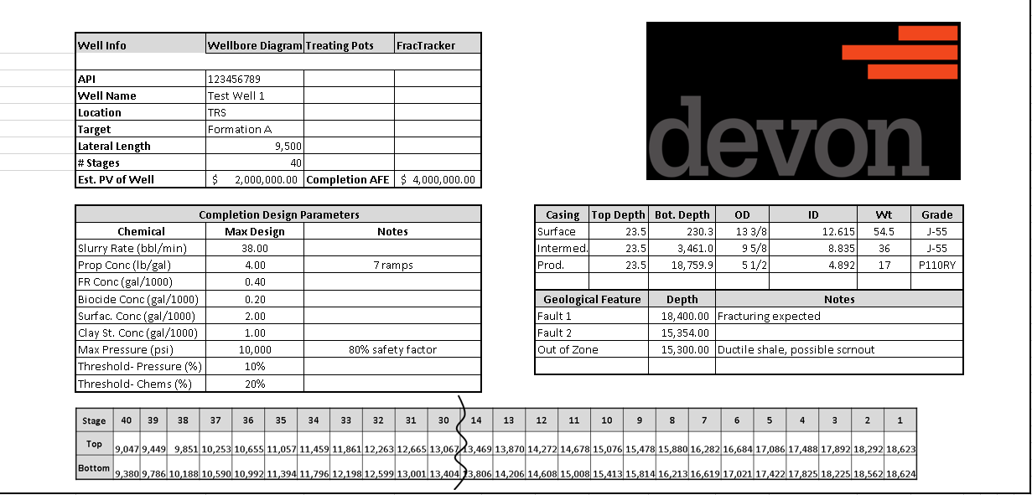
Well Info

Slide 8
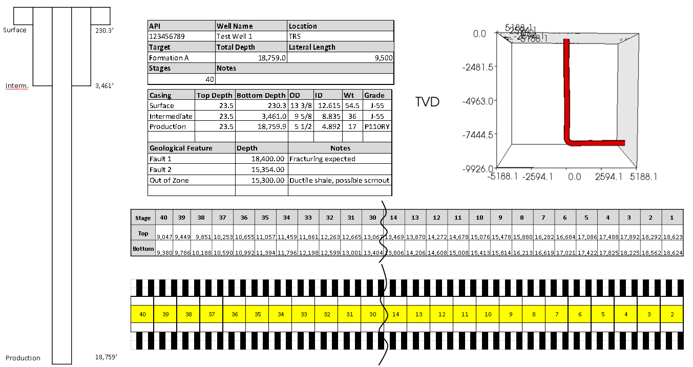
Wellbore Diagram

